Slide 1

ANDHRA LOYOLA INSTITUTE OF ENGINEERING AND TECHNOLOGY
Music Recommendation Application
Based on Facial Expressions
Under the guidance of Ms MD ARSHA SULTHANA
Batch 9
17HP1A0583 (Abdul Saherabegum)
17HP1A0561 (Akhila Umma)
17HP1A0571 (Guthula Jayasri Sai Nikitha)

Slide 2


Introduction
Music is the form of art, which is known to have a greater connection with a person’s emotion. It has got a unique ability to lift up one’s mood.
Our project focuses on building an efficient music recommendation system
which determines the emotion of user using Facial Recognition techniques.
It has widely attracted attention due to its enormous application value and market potential. Face recognition Technology is being implemented in various fields like security system, digital video processing, and many such technological advances. Moreover, on a larger dimension, this would render savage of time and labor invested in performing the process manually. We use Viola Jones algorithm for face recognition and Fisher Faces classifier for identifying facial expressions. The overall concept of the system is to recognize facial emotion, mood and recommend songs efficiently.
The proposed system will be both time and cost efficient.

Slide 3
Problem Statement
Our primary goal is to recommend music
by detecting the mood of a person.
As music holds the power to cheer up a person’s mood, Our project aims to recommend the best playlist which matches the mood of a person and ends with cheerful music.

Slide 4
Project Objectives
Everyone battle with emotions due to different reasons. Ultimately everyone want to be happy.
Creating an application which can make a person happier by detecting the mood of a person using facial recognition techniques.

Slide 5
Scope
People with Internet access and have interest in Music irrespective of age group, gender, ethnicity and occasion.

Slide 6
Methodology
Viola Jones Algorithm is an object detection framework proposed in 2001 by Paul Viola and Michael Jones. This algorithm is primarily used for Face Detection.
Detection
Training
Output

Slide 7
Methodology
Fisher face classifier is one of the most widely
used face mood detection technique
because of it’s effort to maximize the separation
between classes in the training process.
This classifier is based on Linear Discriminant Analysis, a supervised technique.
Recognizer will be trained with numerous samples.

Slide 8
Methodology
HTML will be used for creating web page with a user friendly interface.
PHP will be used for connecting database.
CSS will be used for styling the web page.

Slide 9
System Architecture
VIEW
Browser
Controller
Login/
Signup
Home Page
Playlist
Recommender
Authentication
Image Capture
Algorithm
Model
SQL Database

Slide 10
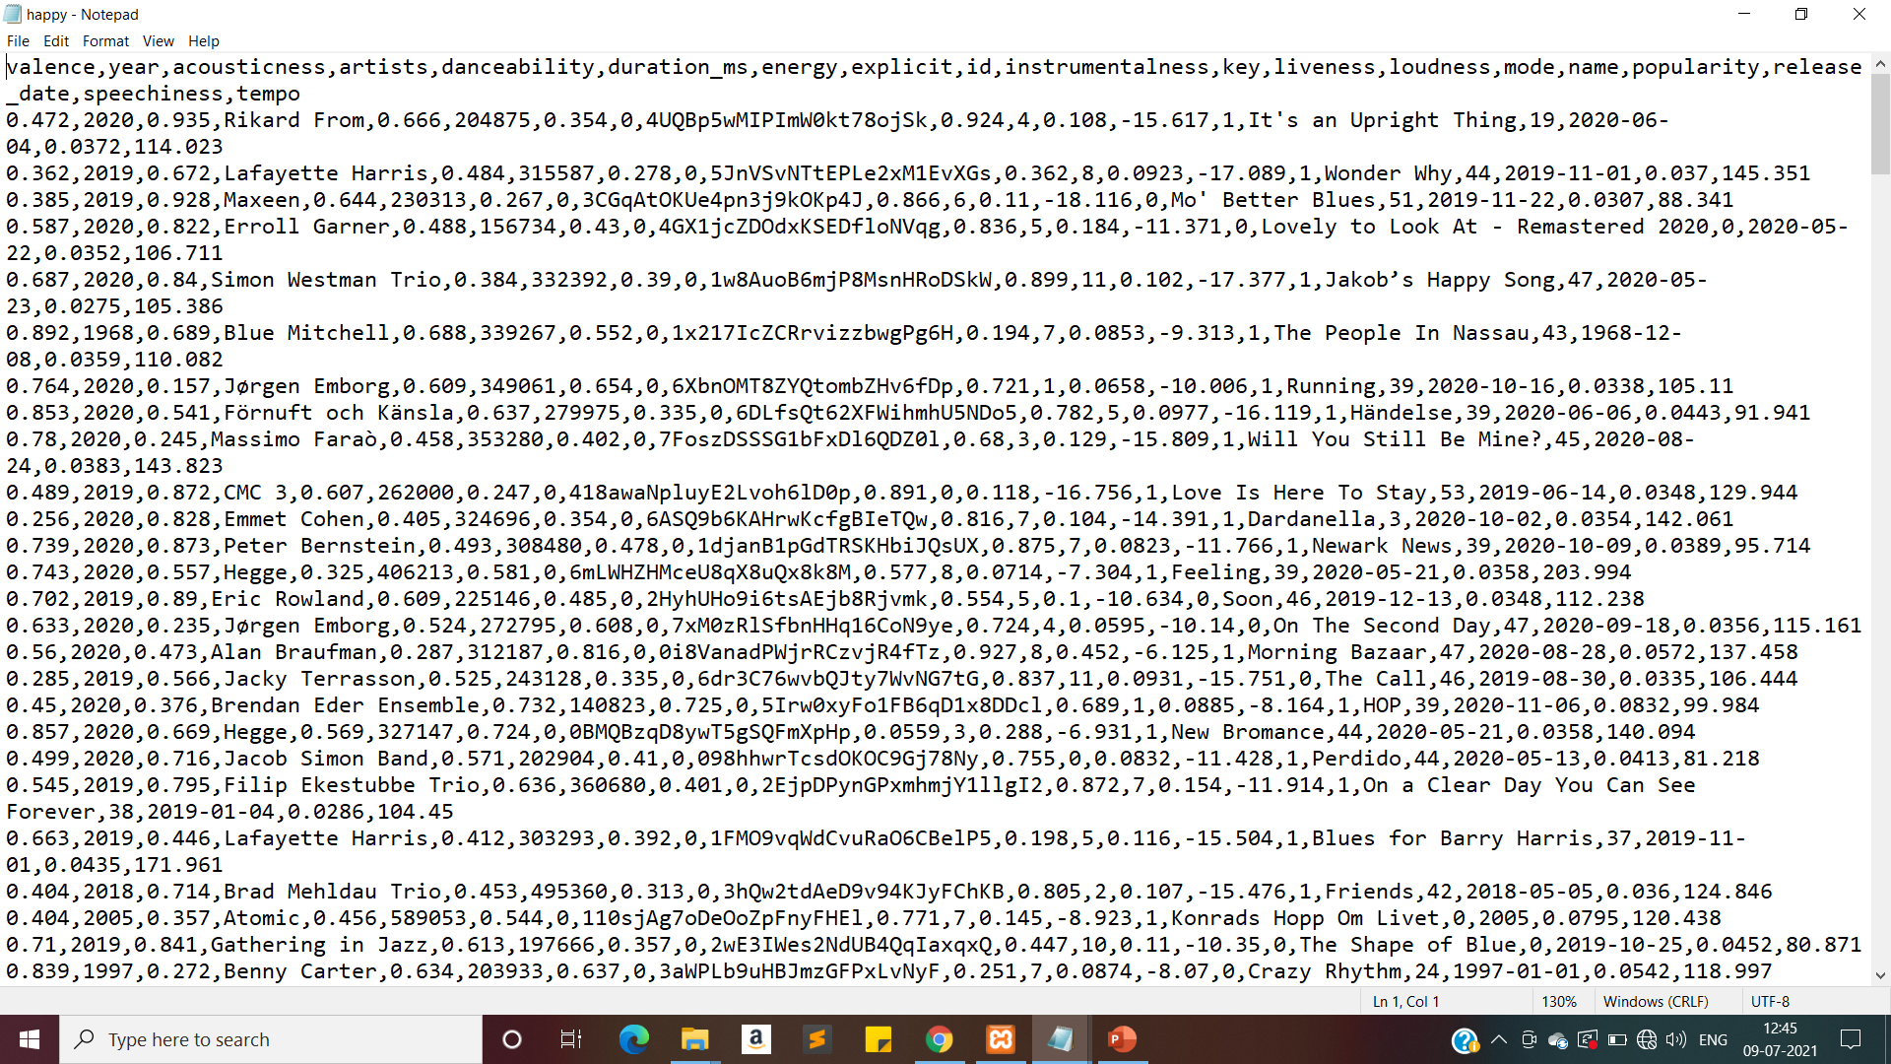
Data Set(happy)

Slide 11
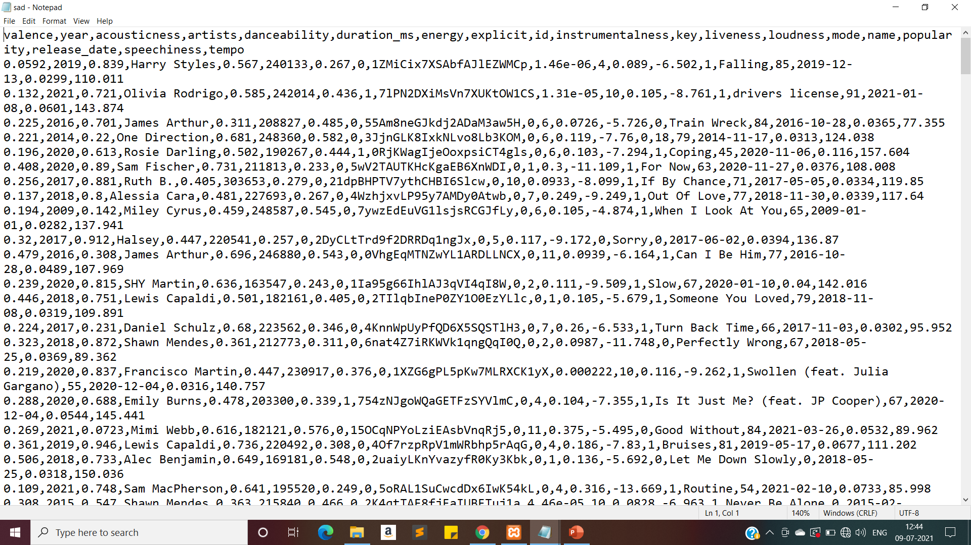
(sad)

Slide 12
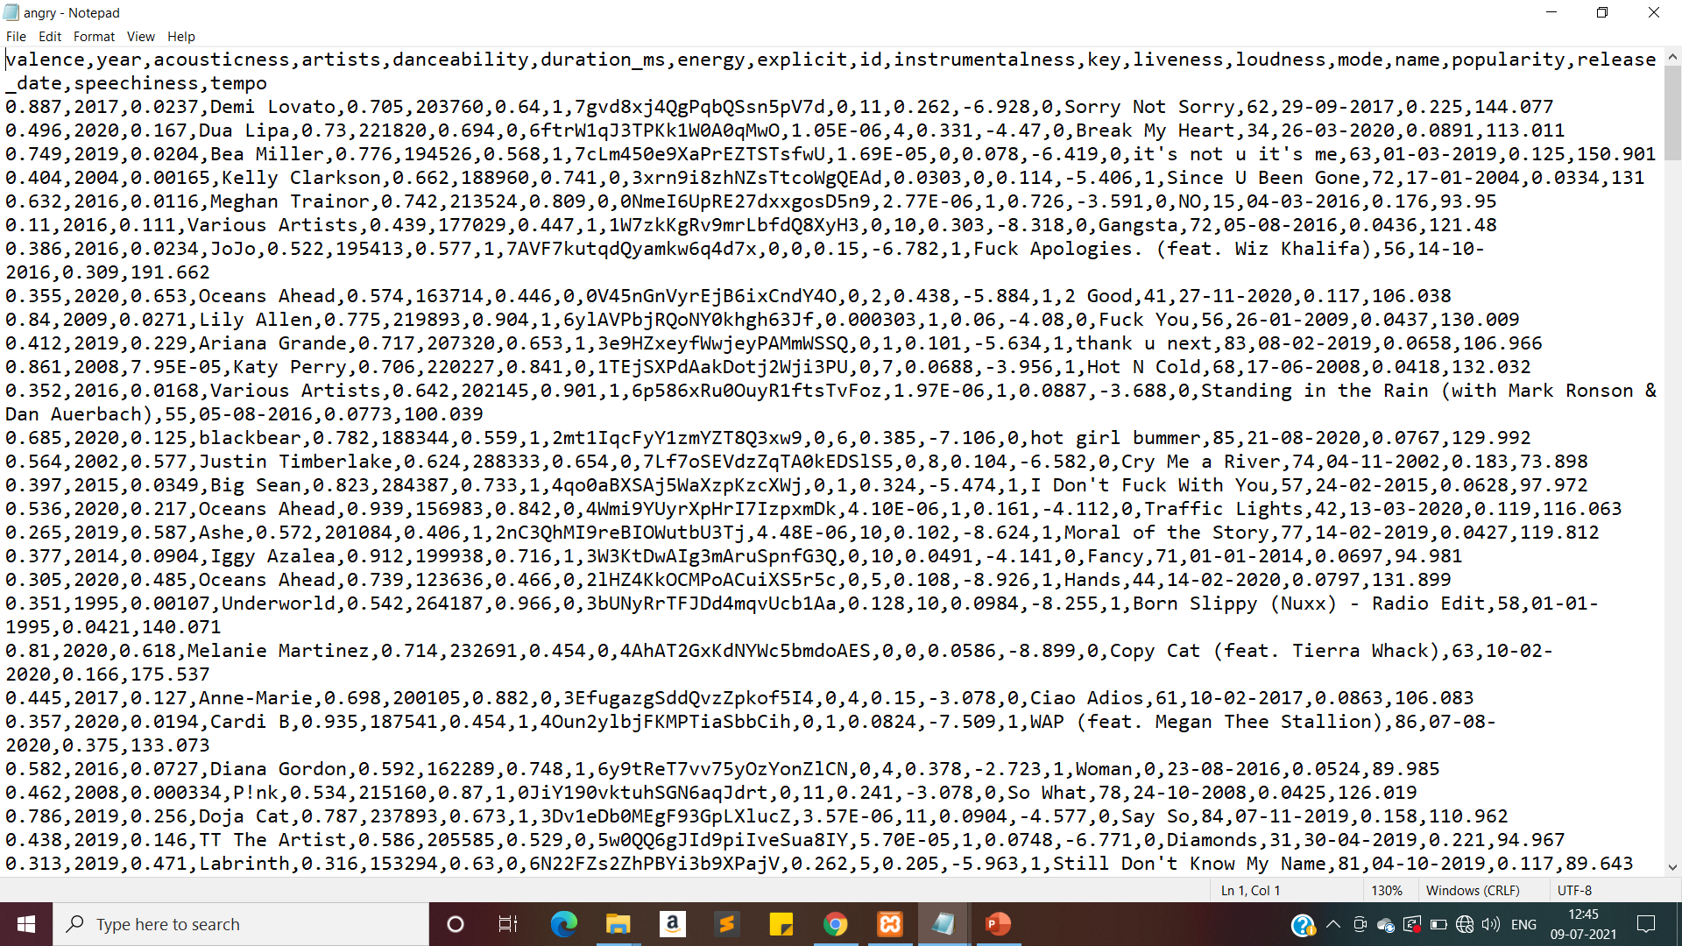
(angry)

Slide 13
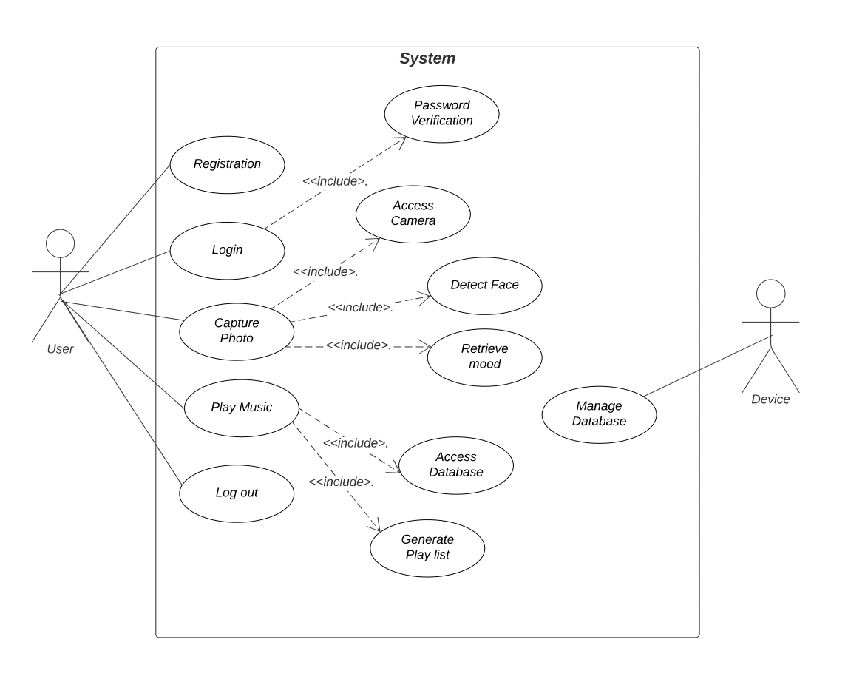
Use case Diagram

Slide 14
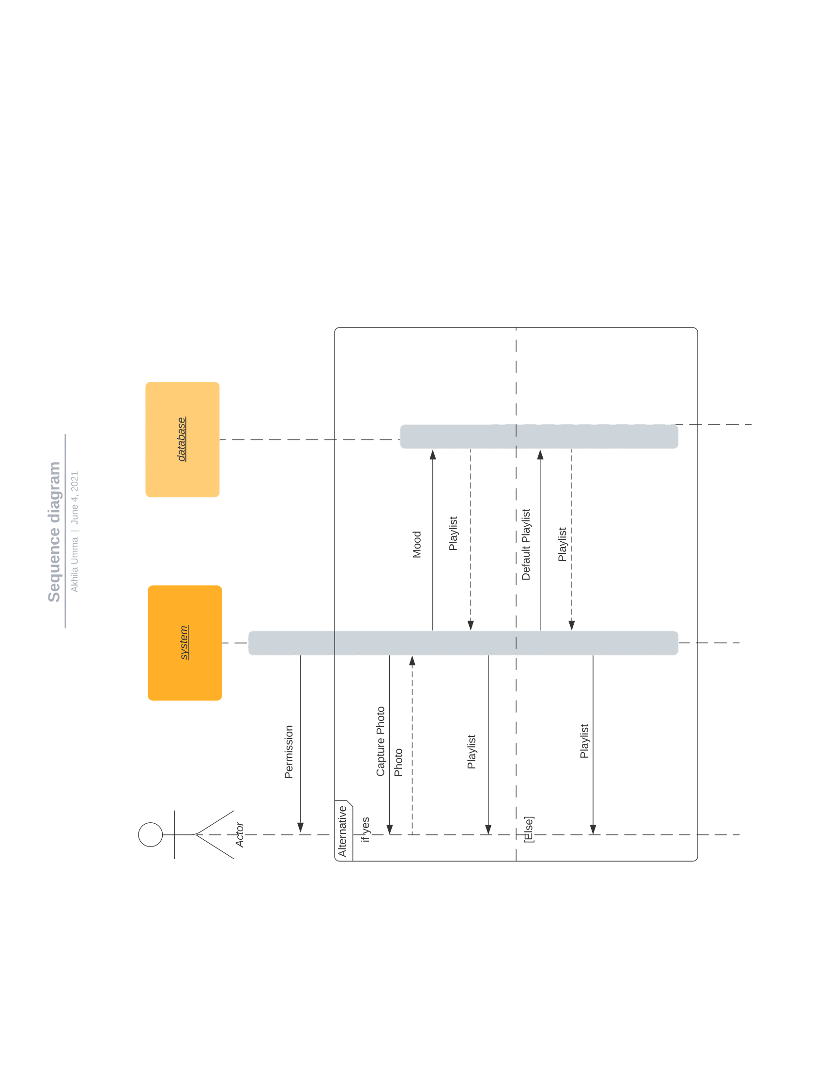
Sequence Diagram

Slide 15
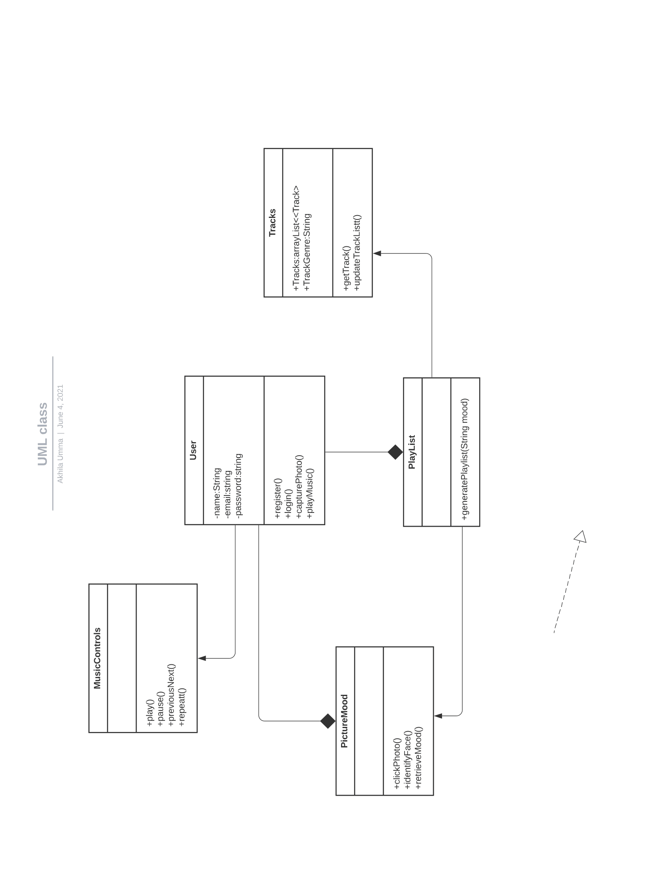
Class Diagram

Slide 16
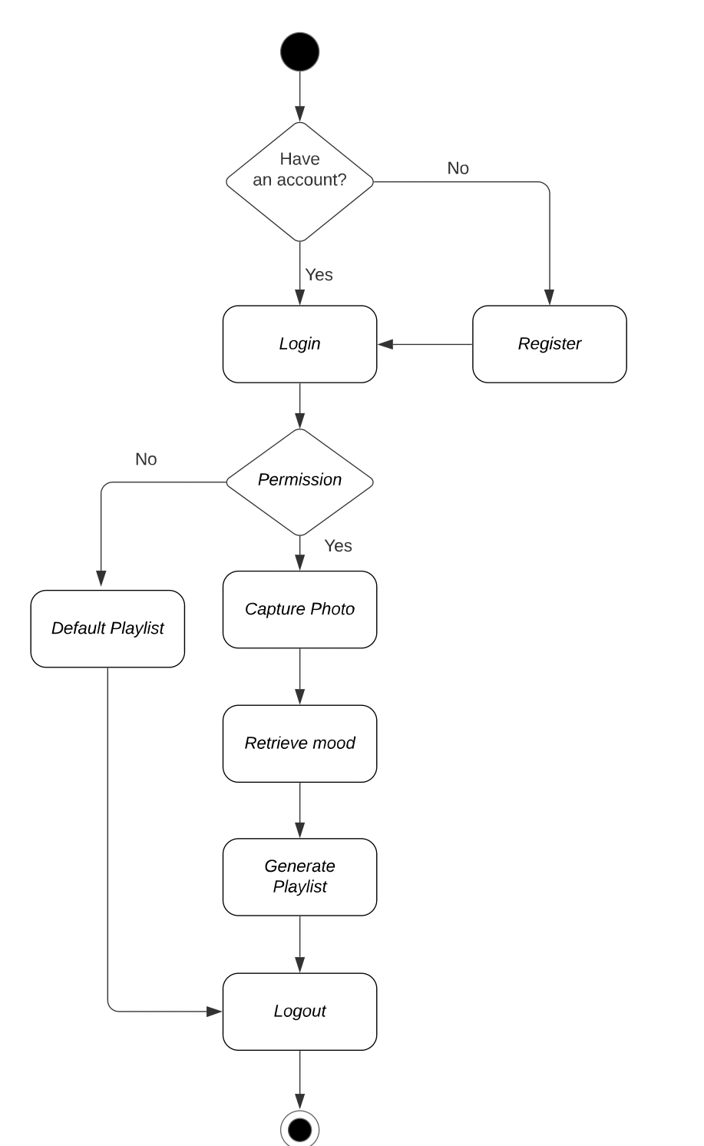
Activity Diagram

Slide 17
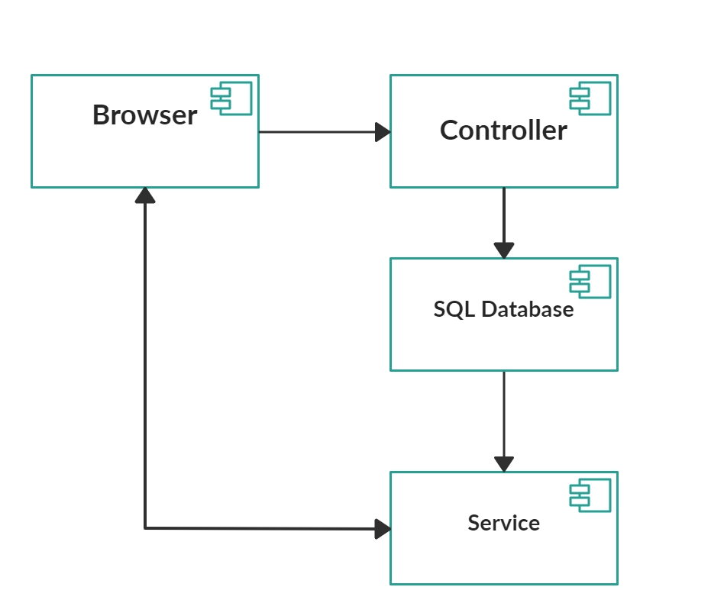
Component Diagram

Slide 18
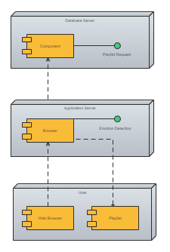
Deployment Diagram

Slide 19
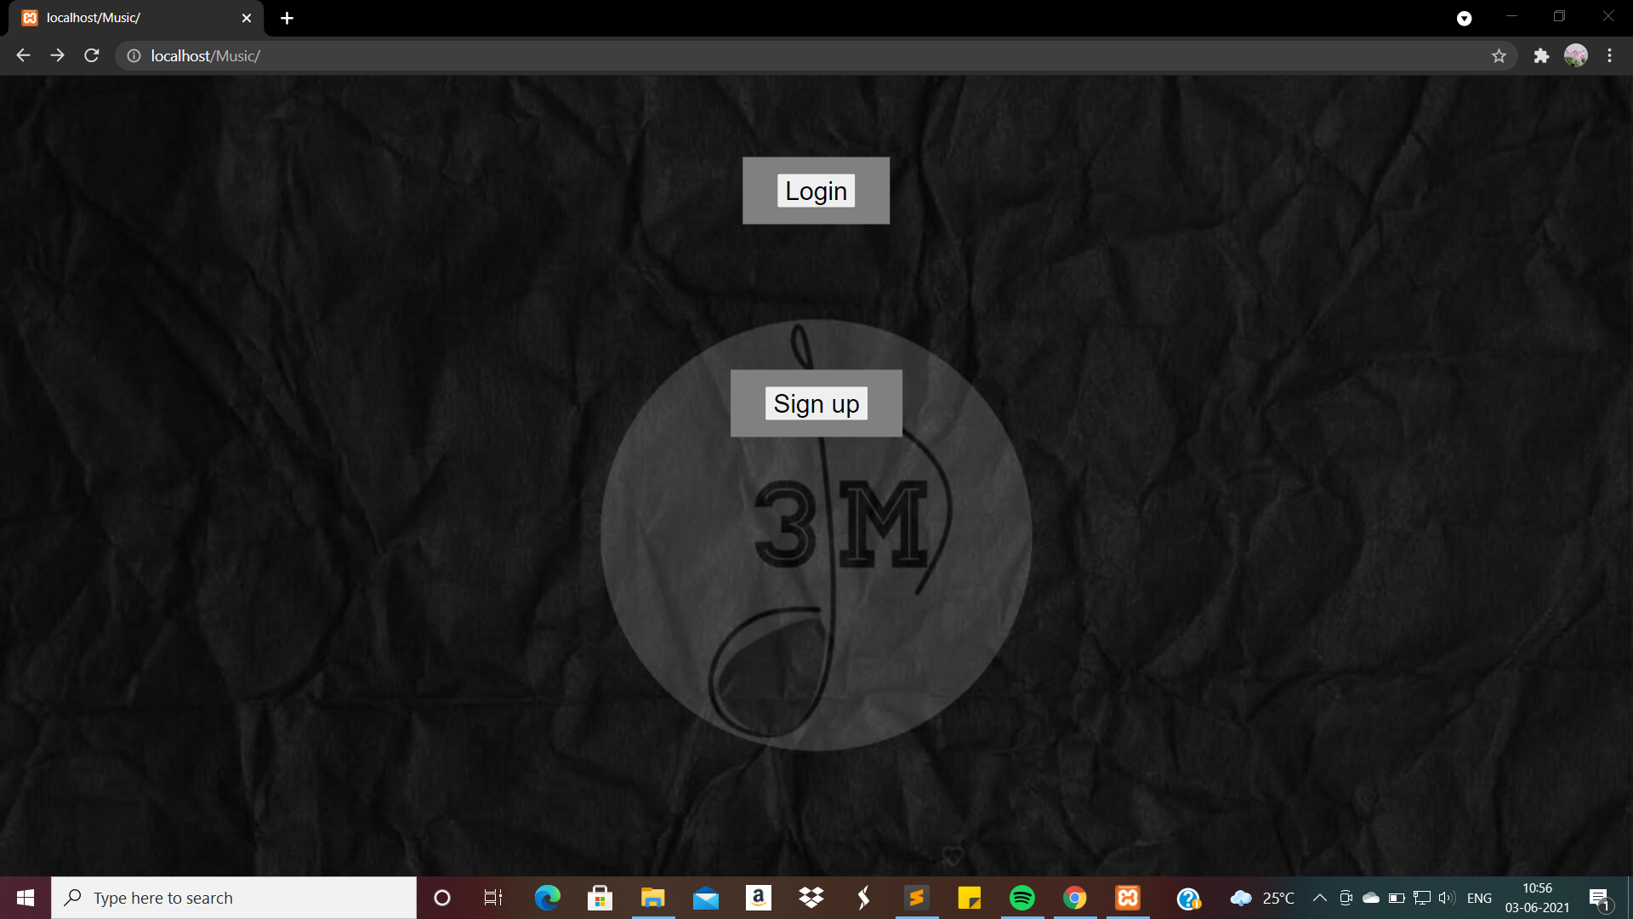
User Interface

Slide 20
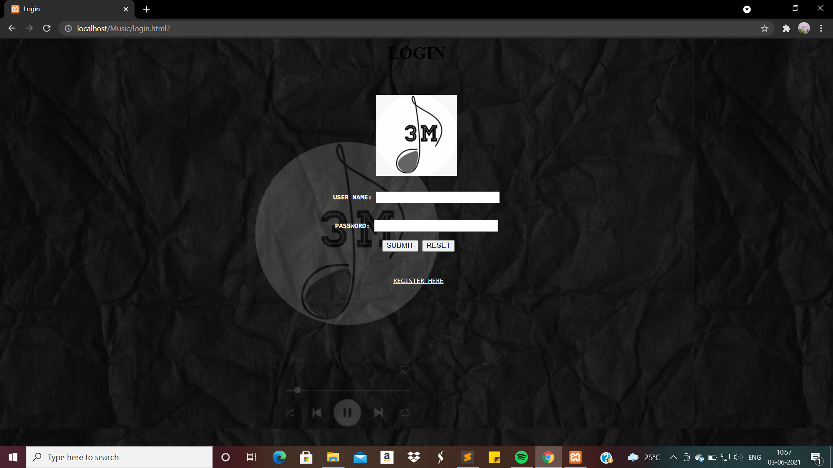
Login page

Slide 21
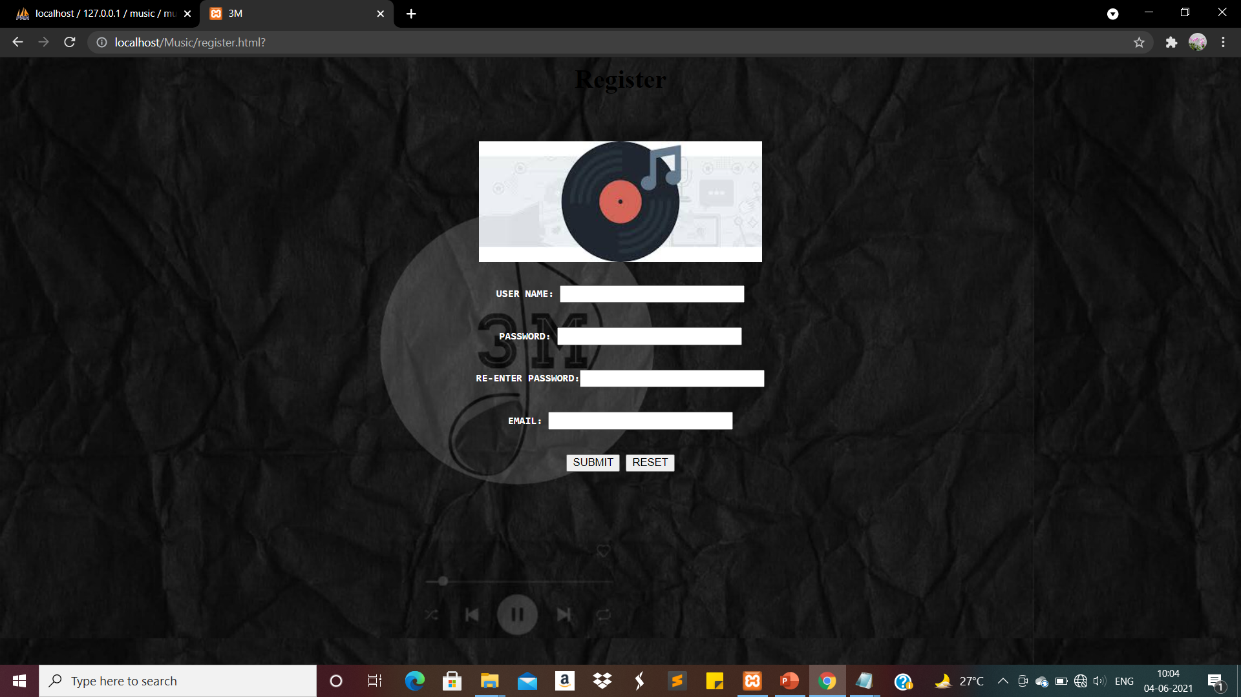
Registration page

Slide 22

User Choice page

Slide 23
Test Cases

Slide 24
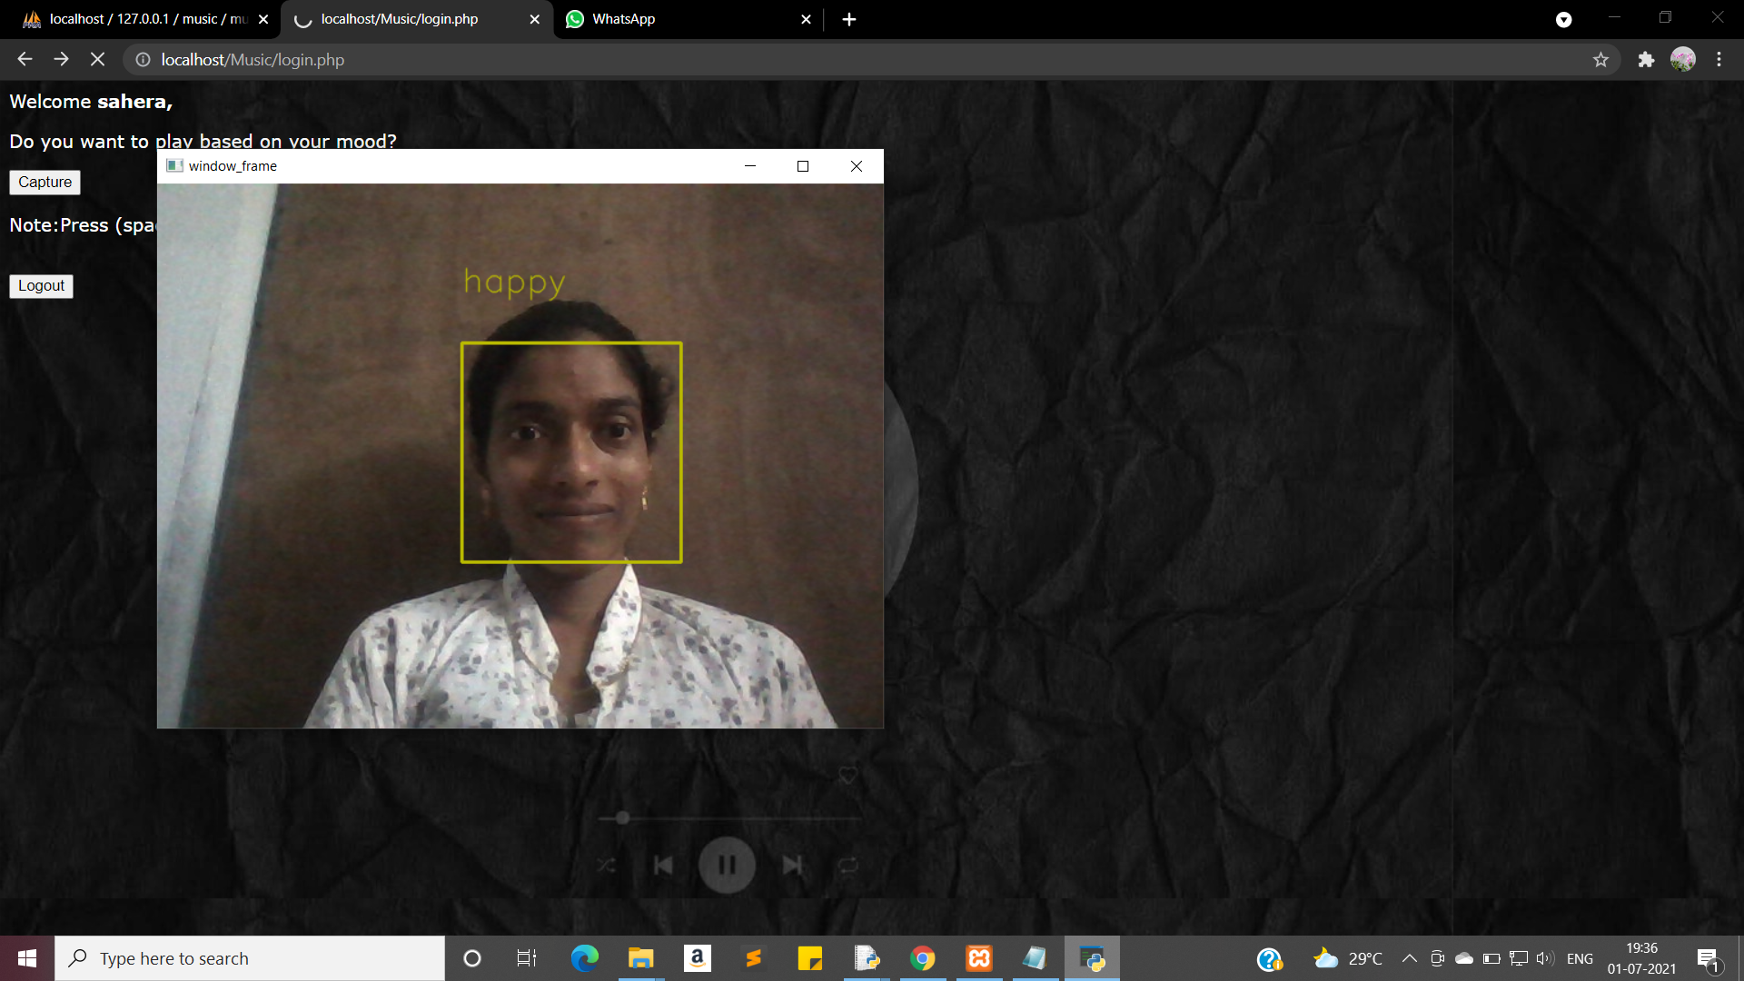

Slide 25


Slide 26

Happy

Slide 27
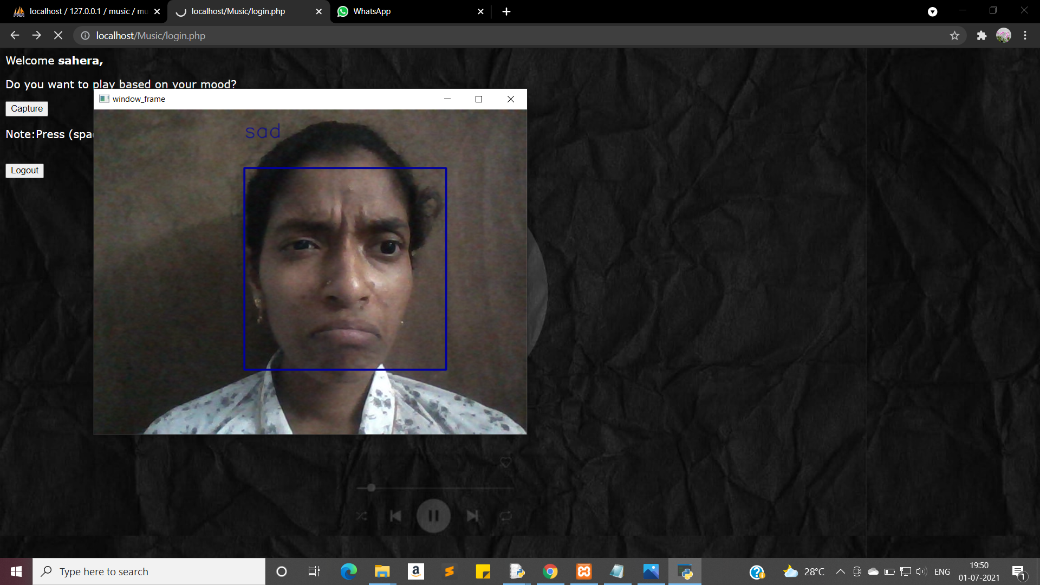

Slide 28


Slide 29

Sad

Slide 30
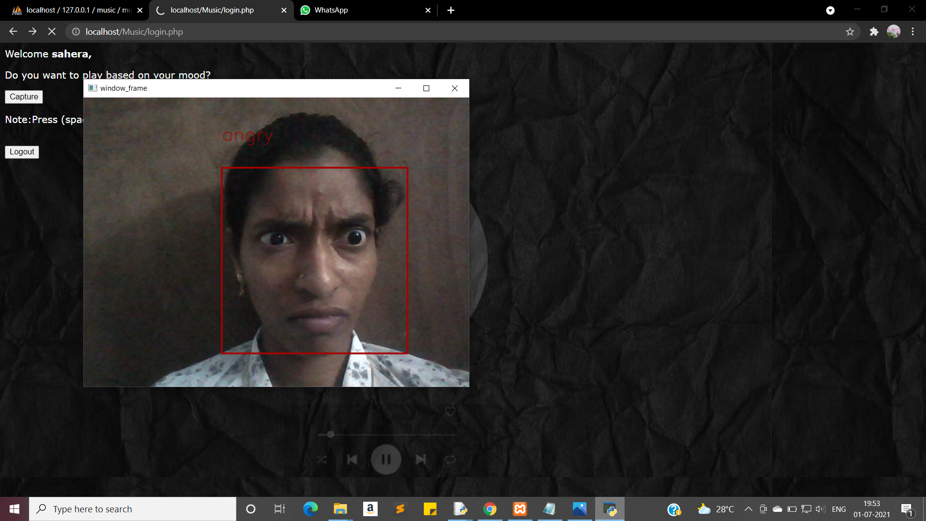

Slide 31


Slide 32

Angry

Slide 33
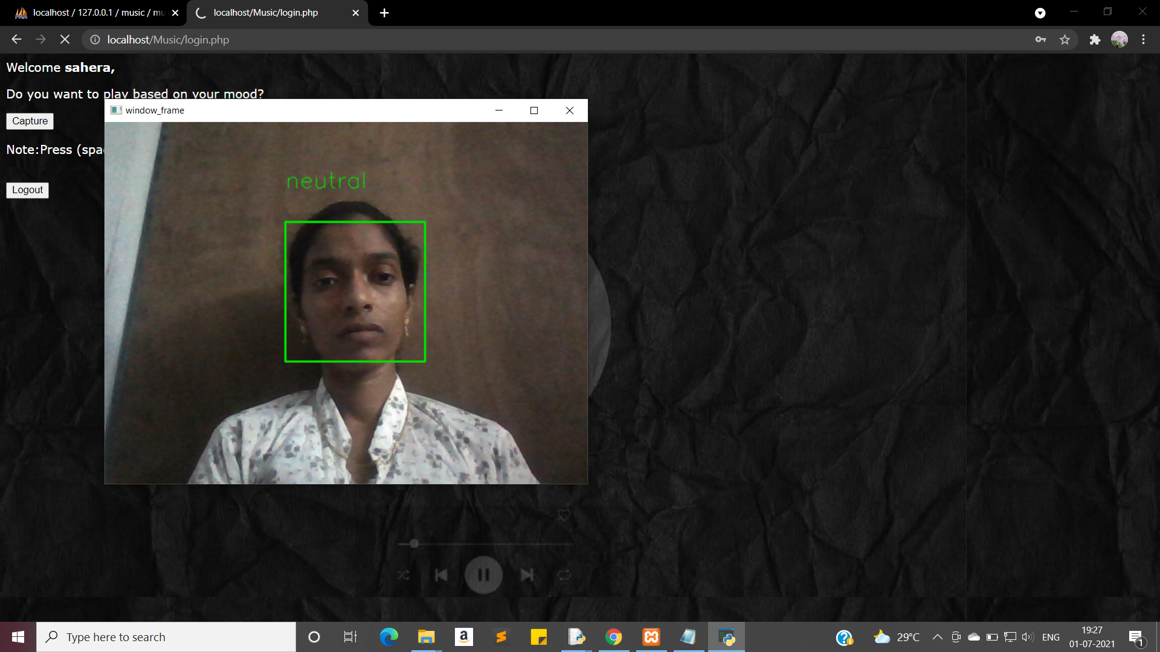

Slide 34


Slide 35

Neutral

Slide 36
Conclusion
A simple system is proposed here for the music recommendation using face emotion recognition. It suggests music by extracting different facial emotion of a person: Happy, anger, surprise, neutral. There is a degree for further upgrades and enhancements. Progressively effective approaches to incorporate different highlights and functionalities should, in any case, be investigated due to the lopsided nature of each element set. It is additionally seen that to improve the exactness of the arrangement framework the informational collection used to construct the grouping model could be expanded further.

Slide 37

Any Queries..?

Slide 38
Thank you..!

